Slide 1
12. Summary
John P. McCrae
CT5166

Slide 2
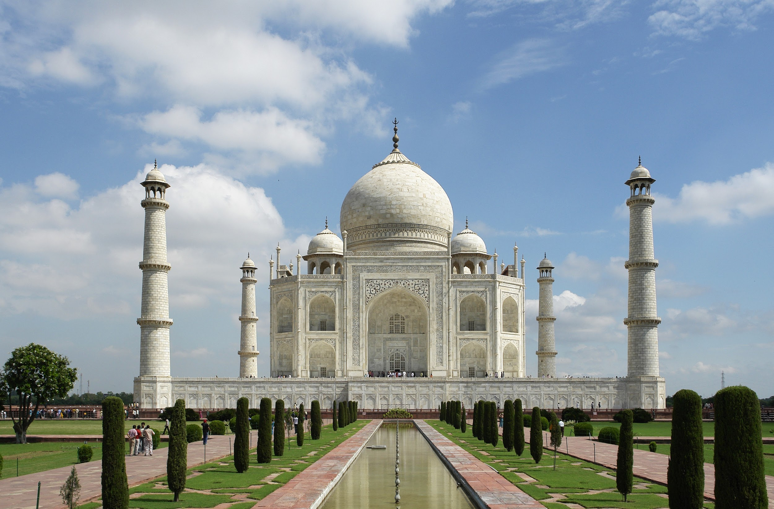
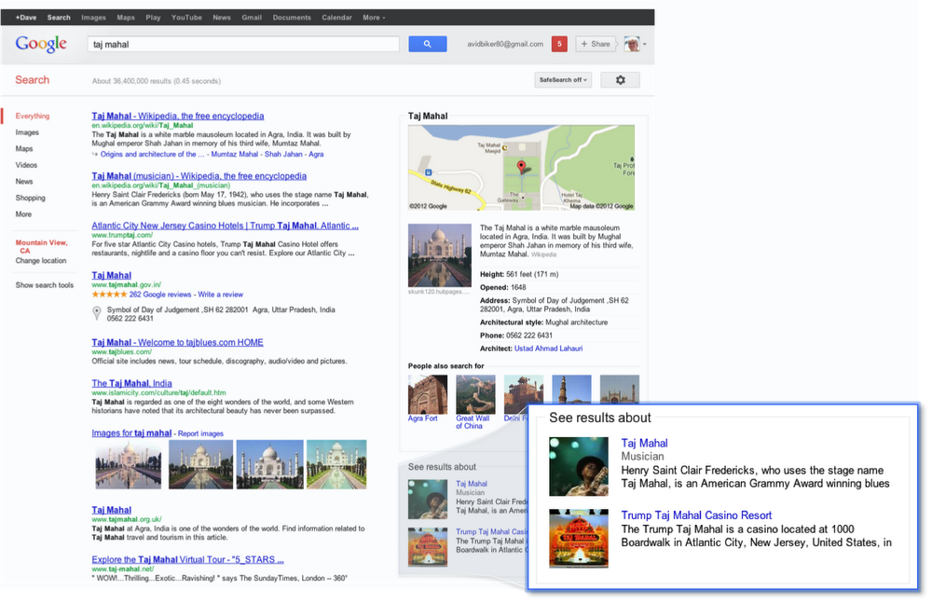
Things, not strings
Taj Mahal
blah blah blah Taj Mahal blah blah blah
blah blah blah Taj Mahal blah blah blah
blah blah blah Taj Mahal blah blah blah

Slide 3
What is a Knowledge Graph?
Ireland
locatedIn
Galway
memberOf
EU
Knowledge graphs use graphs to represent data

Slide 4
Why use a knowledge graph?
Integrate knowledge from different sources
Fast-evolving data representation requirements
Enables powerful reasoning techniques

Slide 5
Models of KGs

Slide 6
Property Graphs
Ireland
locatedIn
Properties: Allow nodes to have numeric, textual and other properties
Galway
population
80k
A property graph is a tuple G=(V, E, R, L, P, U, E’, l), where V is a set of nodes, L is a set of labels, P and R are sets of properties and U is a set of values and E ⊆ V ✕ R ✕ V and E’ ⊆ V ✕ P ✕ U and l: V ∪ R ∪ P → L

Slide 7
Graph Datasets
Cities
Countries
A graph dataset is a pair G = (G_{D}, N) where G_{D} is the default graph and N = {(n₁, G₁), …, (n_{k}, G_{k})} is a set of named graphs

Slide 8
Uniform Resource Locators (URLs)
Domain/Authority
Query
http://www.example.com/path/to/file?query#identifier
Protocol
Path
Fragment

Slide 9
RDF model summary
 | Subject | Property | Object | Example
URI | Allowed | Allowed | Allowed | <http://john.mccr.ae/>
Blank Node | Allowed | Not Allowed | Allowed | _:bnode
Plain Literal | Not Allowed | Not Allowed | Allowed | "abcdef"
Typed Literal | Not Allowed | Not Allowed | Allowed | "10000"^^xsd:int
Lang-tagged Literal | Not Allowed | Not Allowed | Allowed | "Hello, world!”@en
Resources

Slide 10
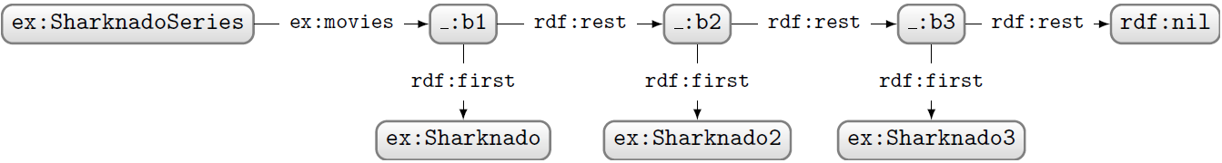
Blank Nodes
Represent an unnamed element
Considered harmful
Useful for structures such as lists

Slide 11
Querying and Serialization

Slide 12
Turtle
Prefixes
@prefix ex: <http://www.example.com/> .
@prefix rdfs: <http://www.w3.org/2000/01/rdf-schema#> .
@prefix rdf: <http://www.w3.org/1999/02/22-rdf-syntax-ns#> .
ex:foobar a ex:Example ;
rdfs:label “foo bar”@en ;
ex:domain ex:example , ex:testing ;
ex:elements ( ex:ex1 ex:ex2 ) .
Continuations
List syntax

Slide 13
Other serializations
RDF/XML
Bulky and unreadable but widely understood
JSON-LD
Extends JSON with a context description
RDFa
For embeddings in web pages
HDT
Efficient binary format

Slide 14
SPARQL
SELECT ?label WHERE {
<http://www.example.com/foo>
rdfs:label ?label
}
Features
UNION
FILTER
OFFSET/LIMIT/ORDER BY
DISTINCT
ASK/CONSTRUCT/DESCRIBE
Property paths
INSERT/LOAD etc.

Slide 15
Schemas

Slide 16
Rule Summary
x type y | y subClassOf z | x type z
x subClassOf y | y subClassOf z | x subClassOf z
x p y | p subPropertyOf q | x q y
x subPropertyOf y | y subPropertyOf z | x subProperty z
x p y | p domain z | x type z
x p y | p range z | y type z
RDF Schema has 7 other rules related to default typing and reflexivity.

Slide 17
Shape Notation
A shape is:
⊤ True
𝚫_{N} The node is a member of N
𝚿_{cond} Some boolean condition holds (e.g., > 0)
𝜑₁∧ 𝜑₂ Both 𝜑₁ and 𝜑₂ hold
¬𝜑 𝜑 does not hold
→^{p}_{𝜑}{min, max} Between min and max edges of type p, whose objects satisfy 𝜑

Slide 18
Context
London
xl:airport
e
London
airport
validFrom
value
rdf:subject
rdf:predicate
rdf:object
Heathrow
1946
Heathrow
e
validFrom
1946
London
airport
Heathrow
airport
1946
e
subPropertyOf
validFrom
validFrom
e
London
Heathrow
1946
RDF*

Slide 19
Deduction

Slide 20
OWL
Open World and No Unique Name Assumption
sameAs/differentFrom
Inverse properties (e.g., parent/child)
Symmetric properties (e.g., sibling)
Transitive properties (e.g., descendent)
Chains (e.g., brother of father => uncle)
Reflexive (e.g., similarTo)
Cardinality (incl. Functional)

Slide 21
OWL
Unions (e.g., Person = Male ⊔ Female)
Intersections (e.g., Mother = Parent ⊓ Female)
Complements (e.g., Dead = ¬Alive)
Has Value (e.g., Cat = ∃ species.felisCatus)
Some Values (e.g., InternationalAirport = ∃ flight.International)
All Values (e.g., RegionalAirport = ∀ flight.Domestic)

Slide 22
Induction

Slide 23
Inductive vs. Deductive
Deductive knowledge involves precise rule-driven generalisations
Inductive knowledge focus on likely knowledge, especially in incomplete graphs

Slide 24
Key graph analytics
Centrality: Which nodes are the most important in a graph?
Community detection: Are there sections of the graph that are strongly interrelated?
Connectivity: Can you reach one part of the graph from another?
Node similarity: Are there patterns in the graph
Path finding/prediction: Provide routes or explanations for connecting entities in the knowledge graph

Slide 25
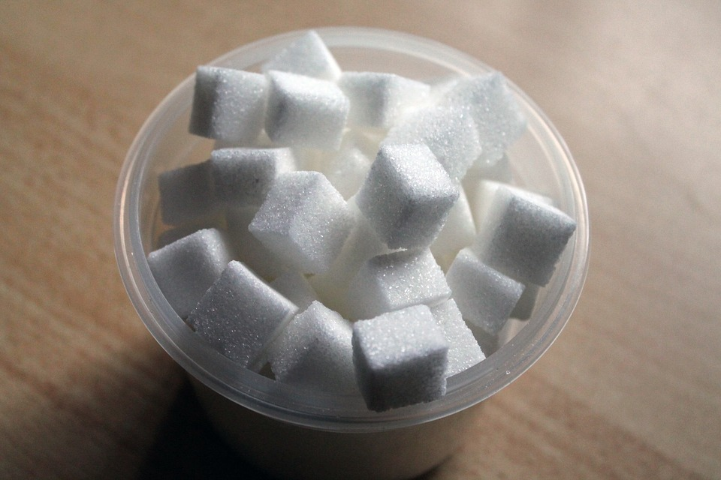

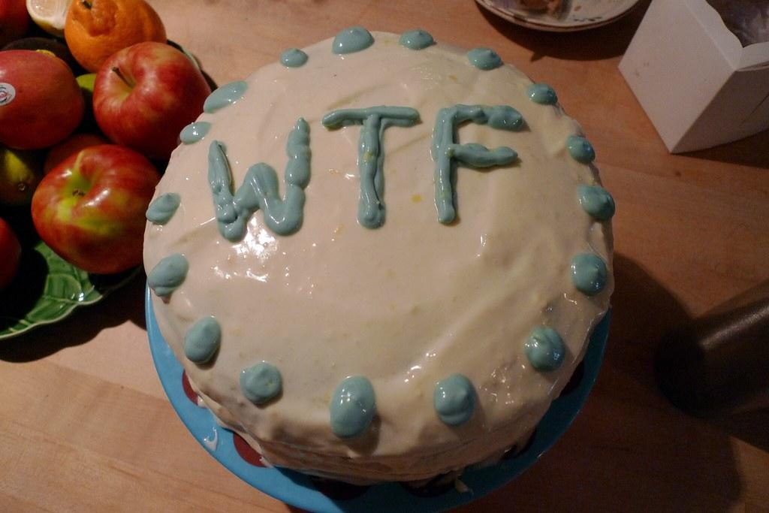
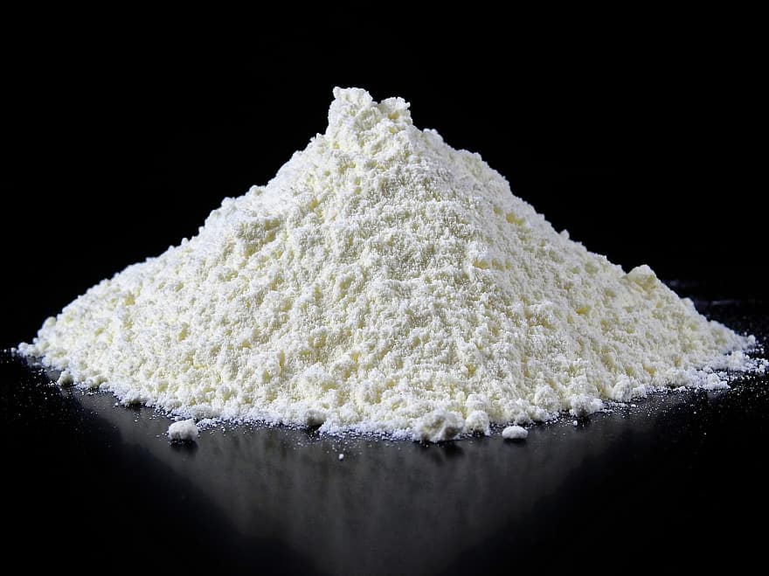
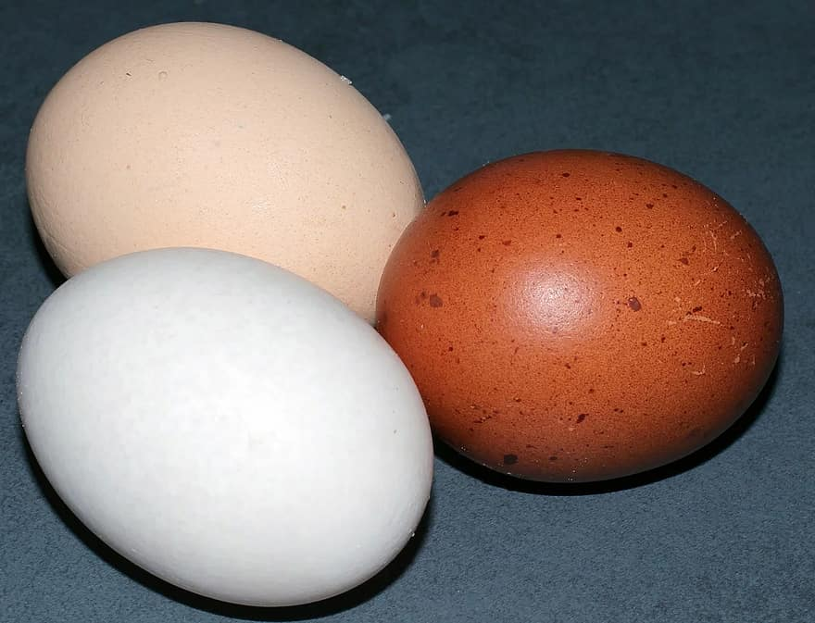
Message passing
Message: A vector of values to send to the next node
Aggregator: A function to combine the messages
End condition: Evaluates if the right result has been achieved

Slide 26
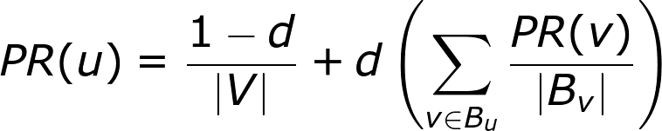
PageRank
The walker may stay at the same node, so there is also a probability, d, that the walker actually jumps
Probability of being at node u
Computation can be done either iteratively or by means of eigenvectors
Nodes connected from current node

Slide 27
Plausibility
We should be able to construct the graph from the embeddings, e_{s}, e_{o}, r_{p}, with a probability function f
f(e_{s}, r_{p}, e_{o}) ≃ 1 if (s, p, o) ∈ E
f(e_{s}, r_{p}, e_{o}) ≃ 0 if (s, p, o) ∉ E
G ≃ Z ×₁ A ×₂ B ×₃C
g_{pqr}= Σ_{i}Σ_{j}Σ_{k}a_{ip}b_{jq}c_{rk}z_{ijk}

Slide 28
Recurrent graph neural network
Recurrent graph neural networks have a hidden representation based on the neighbouring nodes
Christmas
Monster Film
Gremlins
Family Movie
Neural network
Christopher Columbus
Hidden state of node n at time t
Hidden state of neighbours and property embeddings

Slide 29
KG Creation

Slide 30
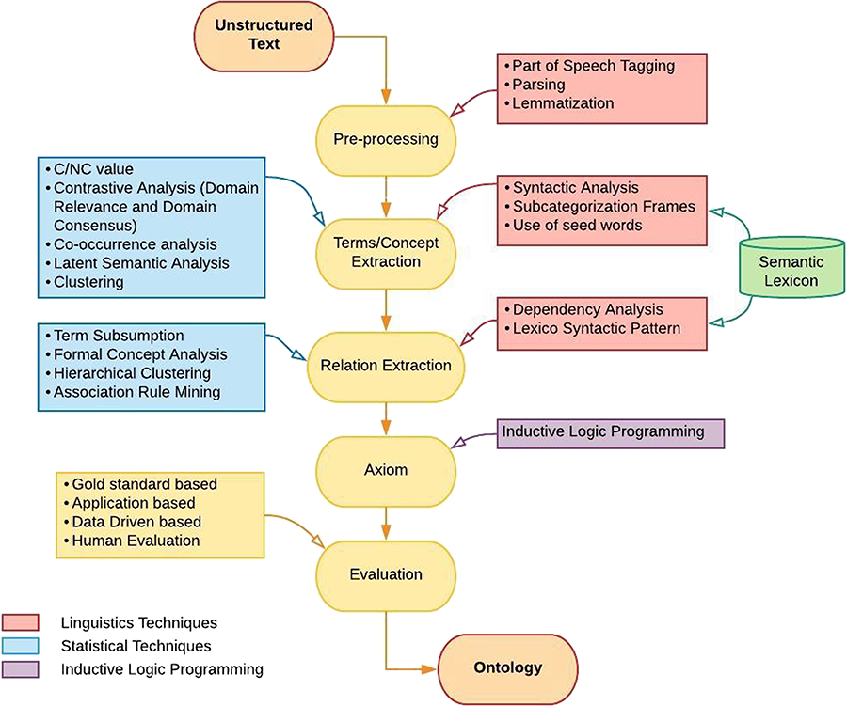

Methodologies of Ontology Learning
Notes:
Figure 3 Methodology of ontology learning.
Unless provided in the caption above, the following copyright applies to the content of this slide: © The Author(s) 2018. Published by Oxford University Press.This is an Open Access article distributed under the terms of the Creative Commons Attribution License (http://creativecommons.org/licenses/by/4.0/), which permits unrestricted reuse, distribution, and reproduction in any medium, provided the original work is properly cited.

Slide 31
Pattern-based Term Extraction
*
*
*
JJ
NN
NNS
NNP
DT
JJ
NN
NNS
NNP
NN
NNP
NNS
IN
NN
NNP
NNS
46th
President
of
the United States

Slide 32
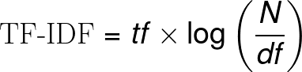
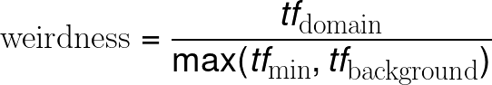
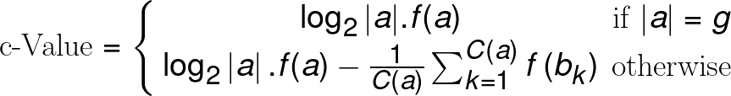
Ranking Metrics

Slide 33
Approaches to relation extraction
Mention-level/Example-based
Rely on a single section of text to infer a relation, e.g.,
“Barack Obama is married to Michelle Obama”
High precision, low recall
Global/Distributional
Use frequency and co-occurrence to infer a relation
“Barack Obama” is often mentioned near “Michelle Obama” they must be related
Low precision, high recall

Slide 34
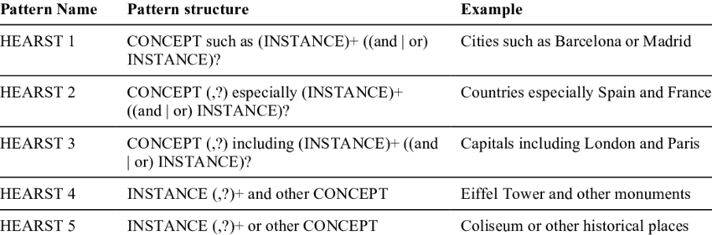
Lexico-syntactic Patterns
We can also use simple regular patterns to extract hypernym relations.
Hearst patterns are used for hypernym detection:

Slide 35
Distant Supervision
Not all patterns will be good… combine this a supervised learning pattern
One feature per pattern, value
is the frequency of the
term.
the X’s Y
X raised its Y
X has Y
2
0
5
true
Snow, Rion, Daniel Jurafsky, and Andrew Y. Ng. "Learning syntactic patterns for automatic hypernym discovery." Advances in Neural Information Processing Systems 17 (2004).

Slide 36
Alignment

Slide 37
Element-level matching
animal
animal
cat
feline mammal usually having thick soft fur and no ability to roar
house cat
domesticated feline
String similarity
Matching constraints
External resources
tabby
tabby

Slide 38
Structure-level matching
animal
animal
cat
feline mammal usually having thick soft fur and no ability to roar
e₁
house cat
domesticated feline
e₂
tabby
tabby
Unique Assignment
Link Prediction (e.g., PPR)
Logic

Slide 39
LogMap2
Create Indexes
Compute Anchors
Repair Mappings
Expand?
Compute Overlap
Create indexes
Group terms according to the words used in their labels
Add New Mapping
Compute Anchors
Find initial mapping based on entities with the exact same label
Repair Mappings
If the ontology is not consistent remove mappings until consistent
Add new mappings
Add partially matching string labels.
Don’t try mappings already attempted
Compute Overlap
Find a single ontology containing only the elements matched

Slide 40

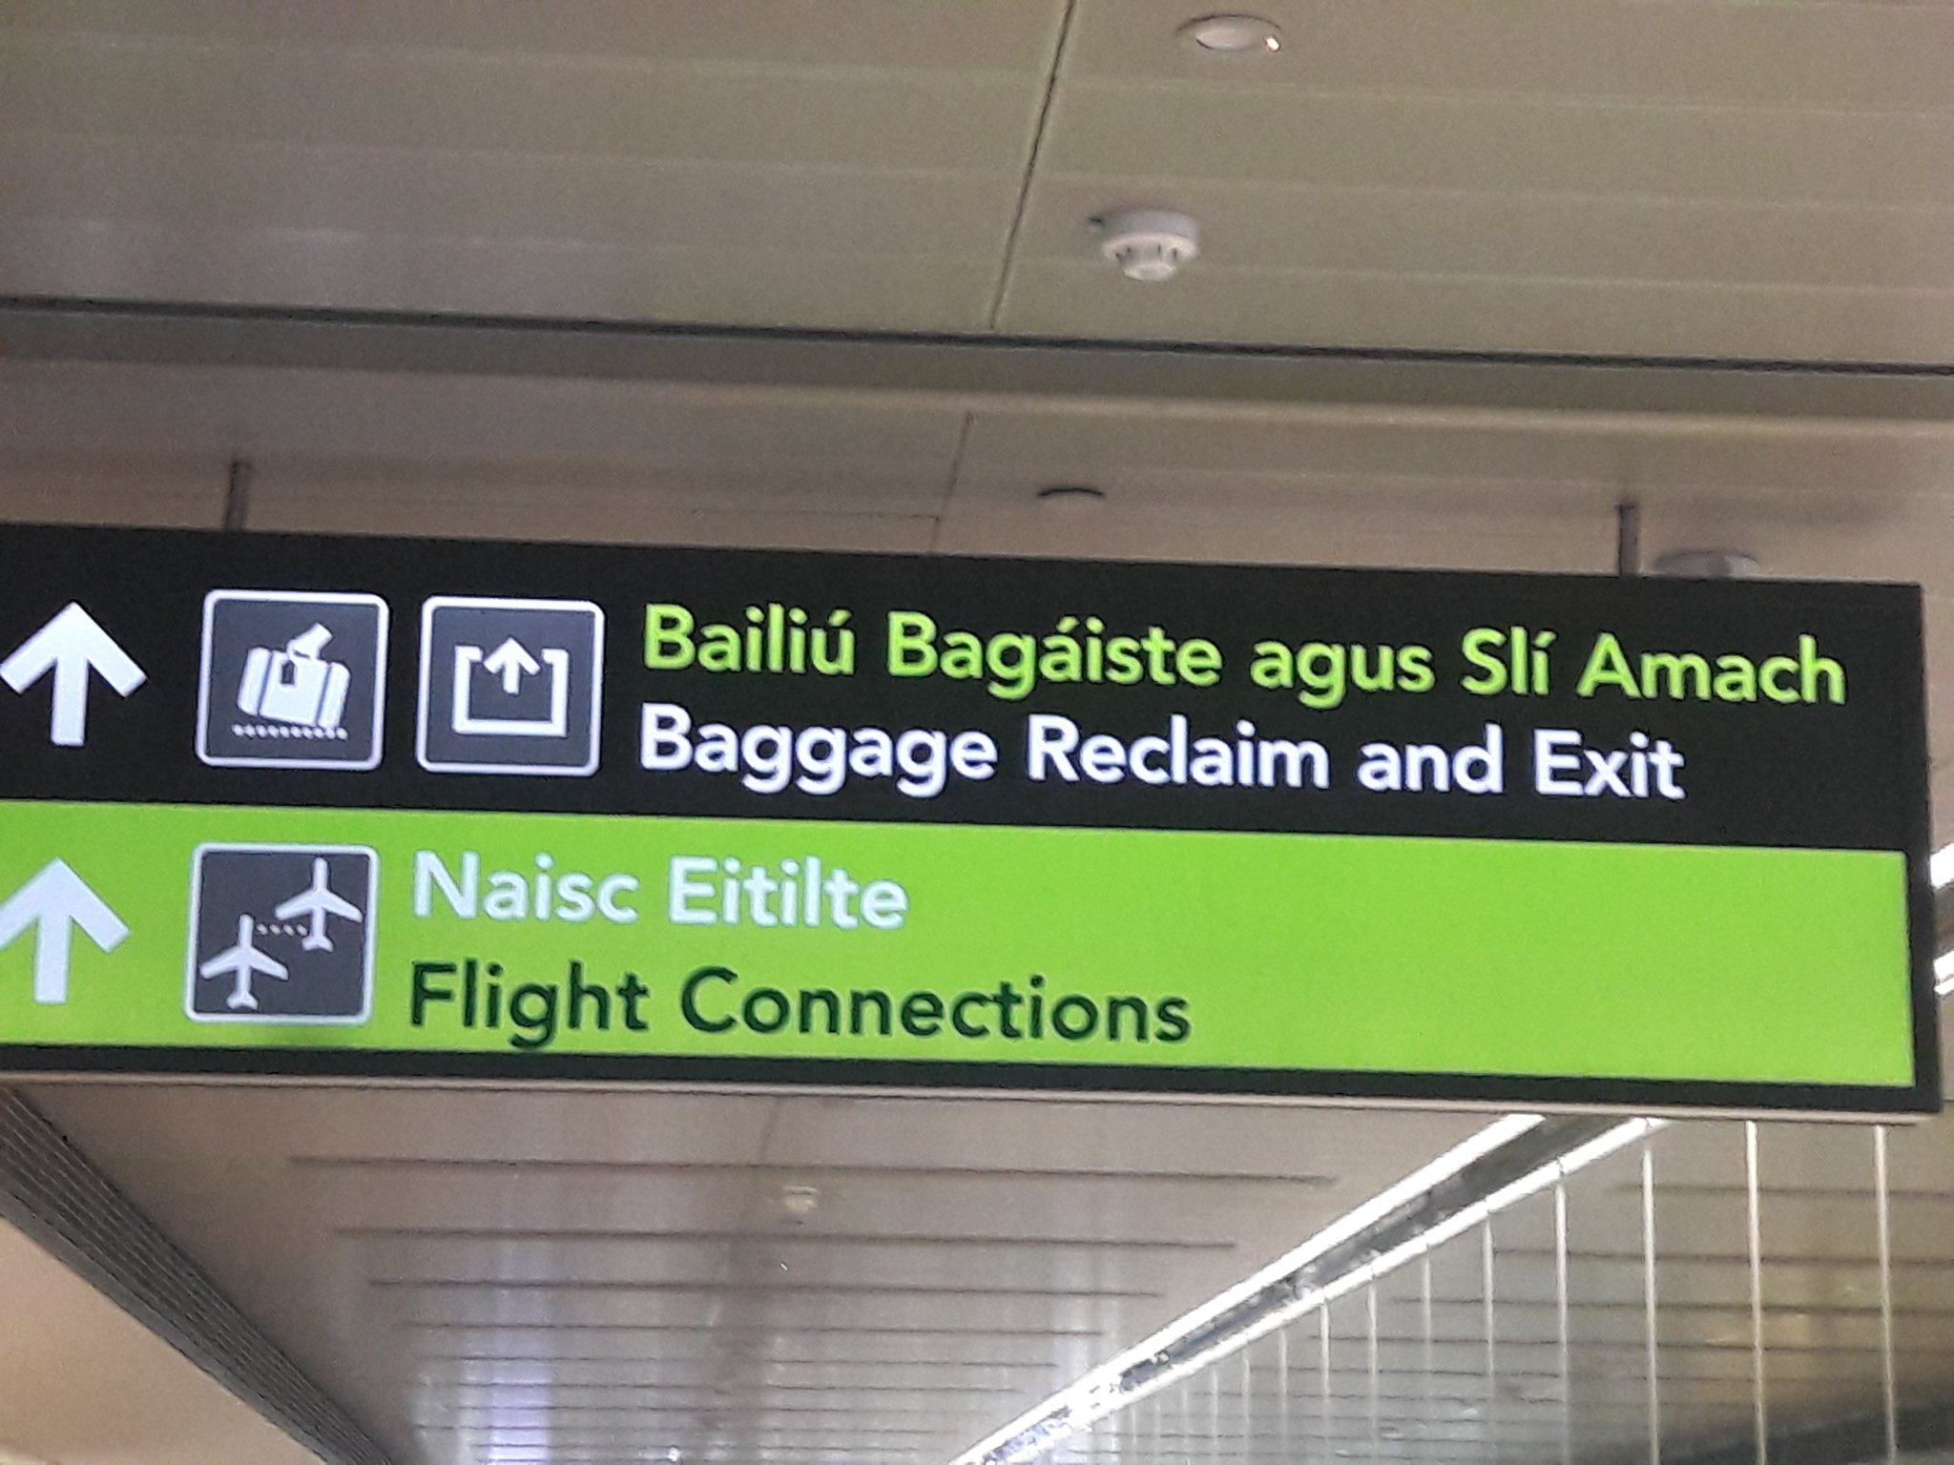
‘Naisc’ means ‘links’ in Irish and is pronounced ‘nashk’.
RDF Doc 1
Blocking
Strategy
Lens
Text
Feature
RDF Doc 2
Graph
Feature
Scorer
SPARQL
Constraint
Matcher
Highly flexible and configurable matching tool
Source: McCrae and Buitelaar http://www.cit.iit.bas.bg/CIT_2018/v-18-1/10_paper.pdf

Slide 41
Publishing

Slide 42
FAIR data
FINDABILITY: metadata, identifiers, registered and indexed
ACCESSIBILITY: standards, separation of metadata
INTEROPERABILITY: common vocabularies, references
REUSABILITY: license, provenance
Notes:
NEW

Slide 43
Linked Data Principles
Principle 1: Use URIs to name things
Principle 2: Use HTTP URIs so that people can look up those names.
Principle 3: When someone looks up a URI, provide useful information, using the standards
Principle 4: Include links to other URIs. so that they can discover more things.

Slide 44




Content Negotiation
http://www.example.com/pipe.html
Humans
Single URL
http://www.example.com/pipe
http://www.example.com/pipe.rdf
Machines
http://www.example.com/pipe.ttl
Turtles

Slide 45
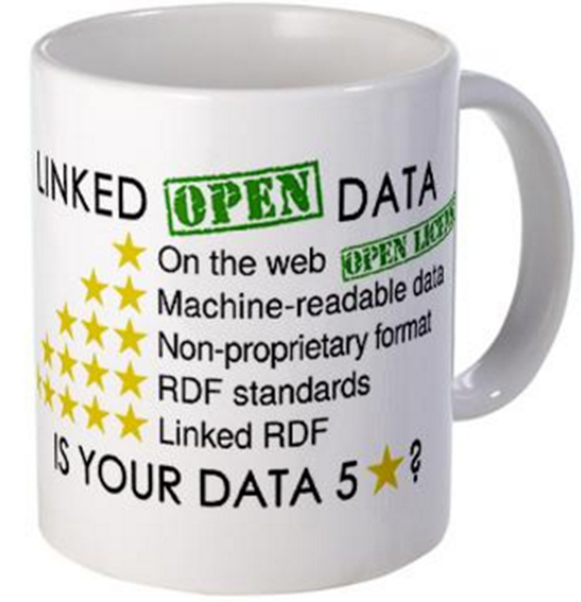
5 Stars of Linked Open Data
★ Publish data under open licence
★★ Make the data “machine readable”
e.g., a Spreadsheet better than a PDF table
★★★ Use non-proprietary formats
e.g., a CSV text file better than Excel
★★★★ Use URIs to name your stuff (hint: RDF)
use unambiguous identifiers that can be linked/looked up
★★★★★ Provide links to other content
so consumers can follow links to find out more

Slide 46
Access trade-offs
Dumps
Fragments
More bandwidth,
less CPU
Pages
SPARQL
Less bandwidth,
more CPU
Notes:
NEW

Slide 47
Linguistic LOD

Slide 48
The promise of linked open data for NLP
Representation and Modelling
Structural Interoperability
Federation
Ecosystem
Expressivity
Conceptual Interoperability
Dynamic Import
Towards open data for linguistics: Lexical Linked Data. Christian Chiarcos, John McCrae, Philipp Cimiano and Christiane Fellbaum, In: New Trends of Research in Ontologies and Lexical Resources, pp 7-25, (2013).

Slide 49
LLOD models
Corpora
NLP Interchange Format (NIF)
Open Annotation
Lexicons
Lexicon Model for Ontologies (lemon)/OntoLex
Other
Marl model for representing “Opinions on the Web“ (sentiment)
OLiA for linguistic interoperability

Slide 50
Simple Entries with Grammatical Info
@prefix ontolex: <http://www.w3.org/ns/lemon/ontolex#> .
@prefix skos: <http://www.w3.org/2004/02/skos/core#> .
@prefix lexinfo: <http://www.lexinfo.net/ontology/2.0/lexinfo#> .
<#cat> a ontolex:Word ;
lexinfo:partOfSpeech lexinfo:noun
ontolex:canonicalForm [
ontolex:writtenRep “cat”@en ;
lexinfo:number lexinfo:singular ] ;
ontolex:otherForm [
ontolex:writtenRep “cats”@en ;
lexinfo:number lexinfo:plural ] ;
ontolex:denotes [
skos:definition “A four-legged, furry animal”@en ] .
LexInfo Ontology
Part of Speech
Inflected Form

Slide 51
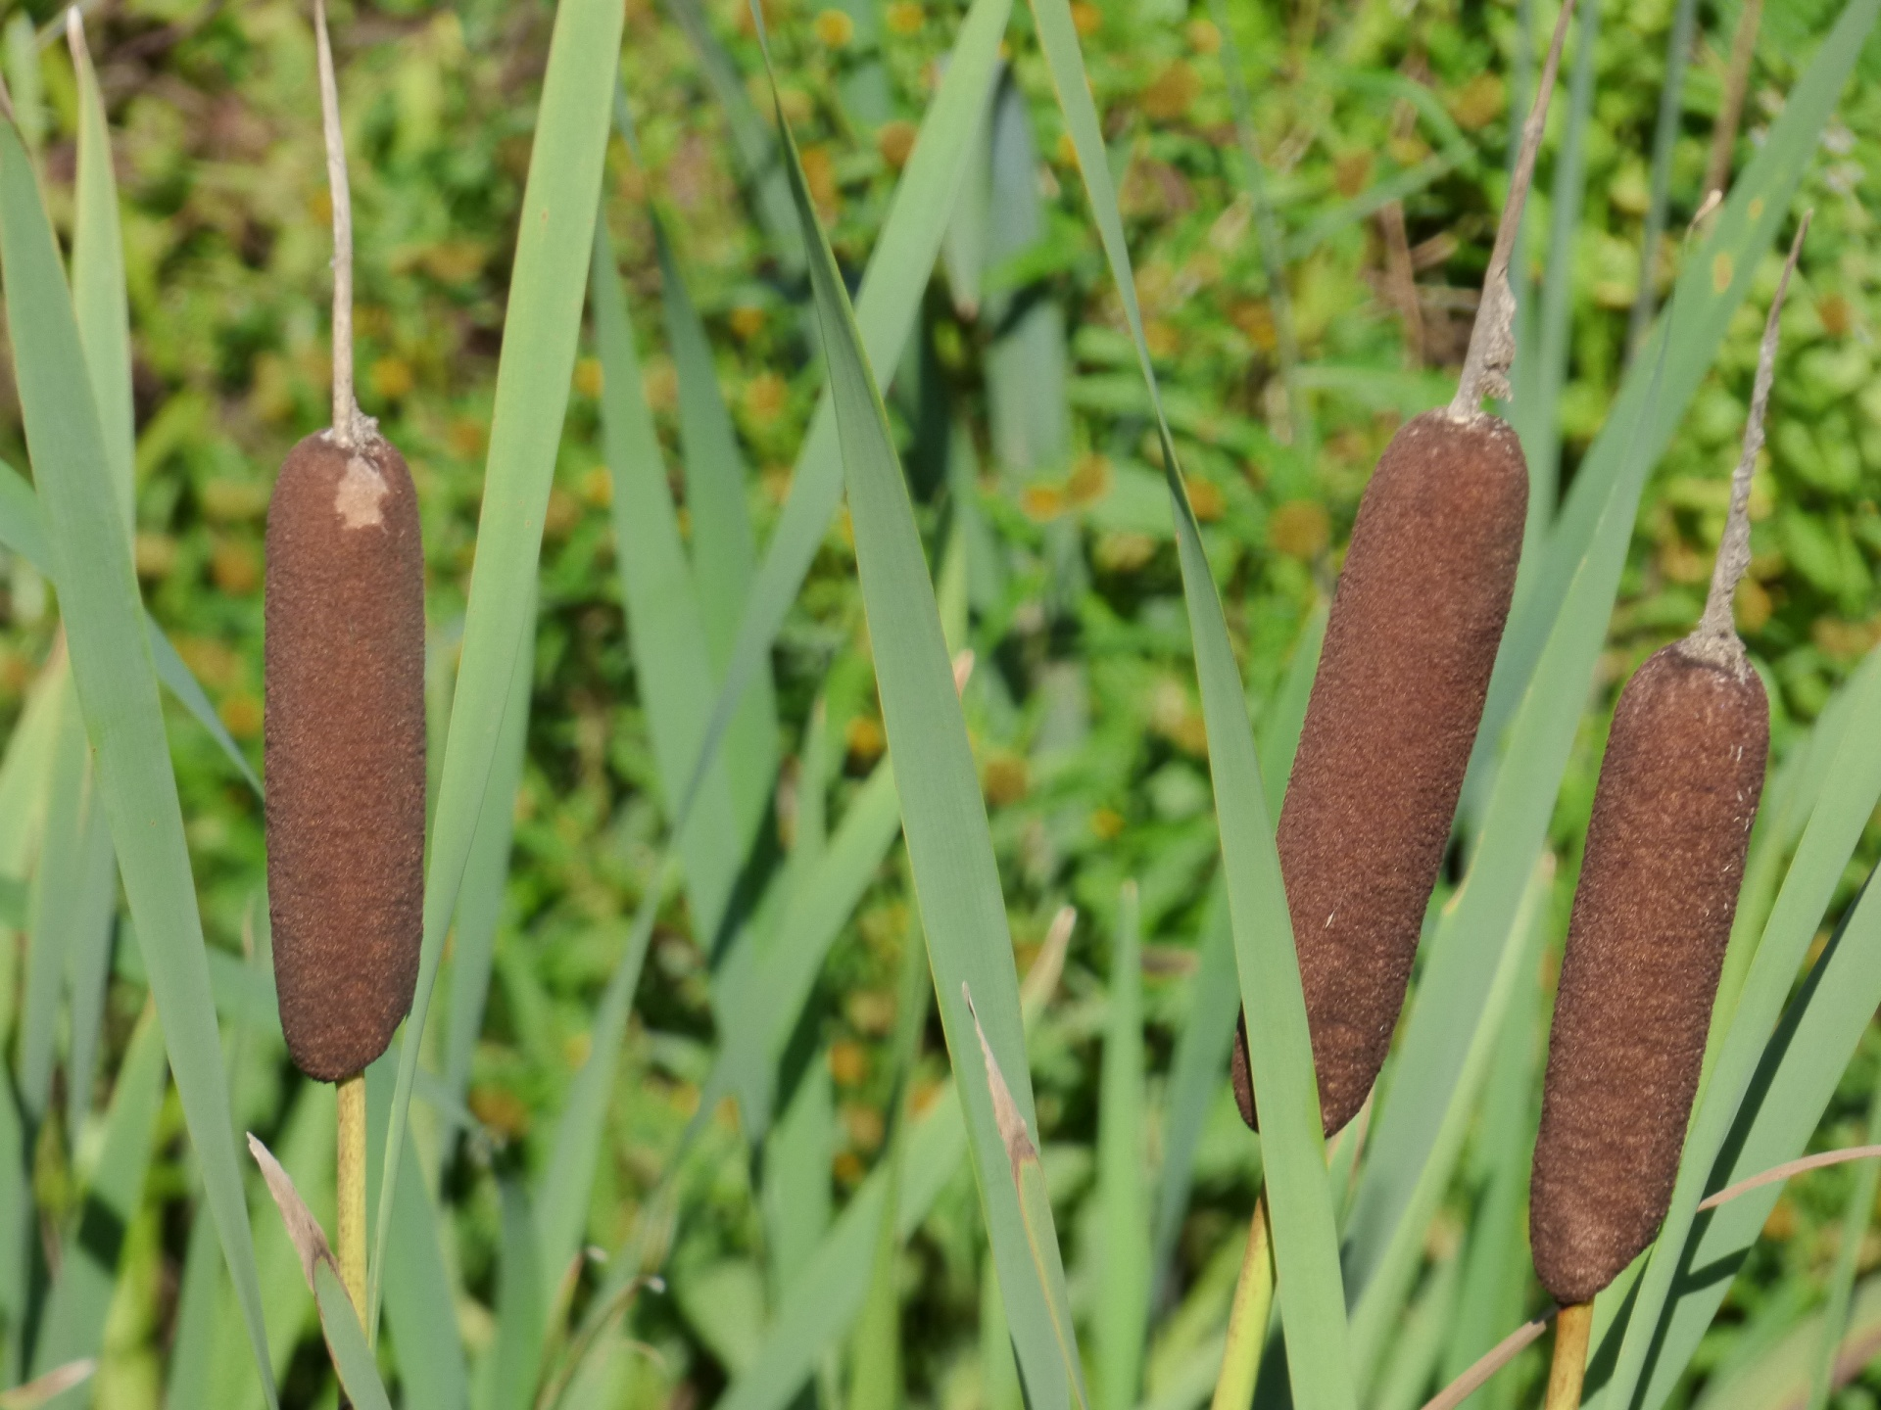
Lexical Senses
@prefix ontolex: <http://www.w3.org/ns/lemon/ontolex#> .
@prefix dbpedia: <http://dbpedia.org/resource/> .
@prefix dbo: <http://dbpedia.org/ontology/> .
<#bulrush> a ontolex:Word ;
ontolex:sense [
ontolex:reference dbpedia:Typha ;
ontolex:usage [ rdf:value “British English” ] ] ;
ontolex:denotes dbpedia:Typha .
<#cattail> a ontolex:Word ;
ontolex:sense [
ontolex:reference dbpedia:Typha ;
ontolex:usage [ rdf:value “American English” ] ] ;
ontolex:denotes dbpedia:Typha .
sense ⚬ reference
=
denotes
Restriction on Lexical Sense

Slide 52
Enterprise KGs

Slide 53
Abstract Reference Architecture
Knowledge Acquisition
Knowledge Consumption
Understanding
Quality Assurance
Entity Summary
Ontology Development
Graph Summary
Exploitation
Data Linking
Semantic Search
Data Lifting
Query Generation
Question Answering
Knowledge Storage
Source: Pan et al., “Exploiting Linked Data and Knowledge Graphs in Large Organisations”

Slide 54
Knowledge Acquisition
Where do we get knowledge from?
Data Lifting: Extraction from legacy sources
Data Linking: Incorporating data from external (open) sources
Ontology Development: Structuring and organising data
Quality Assurance: Validation and improvement of data.
This is a cyclical process; quality assurance makes us get more data or structure the data we have better.

Slide 55
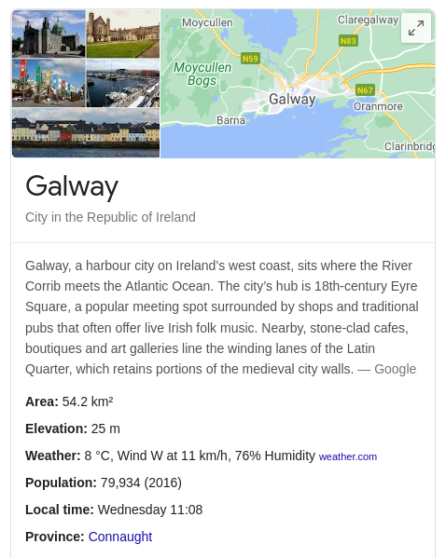
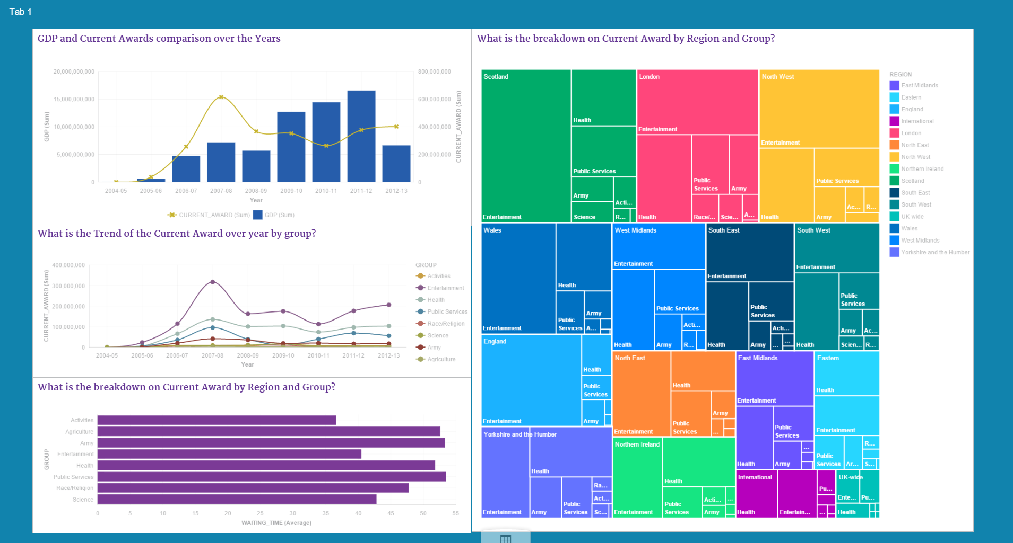
Understanding
What can we learn from the knowledge?
Understanding
Summarize the knowledge into actionable reports
Entity summarization focuses on a single element of the graph
Graph summarization focuses on the whole graph
Entity Summary
Graph Summary

Slide 56
Exploitation
How can we use the knowledge?
Semantic Search: Improve search by using knowledge graph entities
Query Generation: Quickly write (SPARQL) queries using knowledge graph
Question Answering: Answer full questions in natural language.

Slide 57
Competency Question Ontology Authoring
Formulate Questions
Extract
Requirements
Create Tests
Author Ontology

Slide 58
Question Answering over Knowledge Graphs
Linguistic Analysis
Map the extracted terms to URIs
Entity Mapping
Combine triples into a single SPARQL query
Use NLP tools to analyse the queries and construct linguistic triples <subject, predicate, object>
Triple Identification
Find triples that combine the URIs filtering for domain/range restrictions
Query Formulation
Source: PowerAQUA by Lopez et al., http://oro.open.ac.uk/32164/1/swj102_2.pdf

Slide 59
Good luck with the exam!

